Slide 1
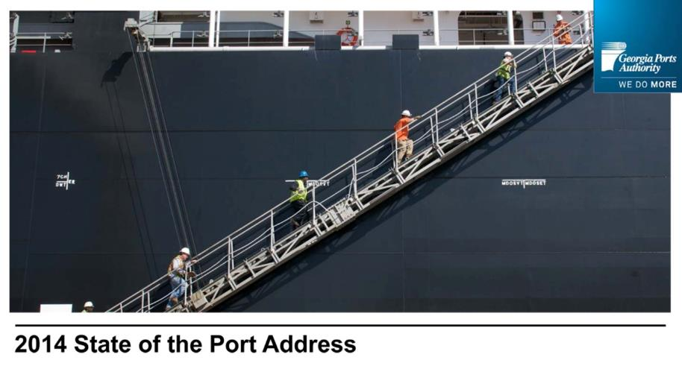
Georgia Ports Authority
State of the Port
Visual Only Presentation
Use this area for logo
(delete text box before placing logo)

